Slide 1



RUNNING GENAI ON INTEL AI LAPTOP
Leveraging openvino for efficient inference and fine-tuning
Presented By,
INTELlect Innovators
Farhan khan K A
Sowmya G M
PESITM , Shivamogga

Slide 2
Problem statement:
GenAI on intel AI laptops and simple LLM inference on CPU and fine tuning of LLM models using intel Openvino.
Challenges in running GenAI models on local systems due to compatibility and hardware constraints.
Need for efficient inference and fine-tuning of large language models on accessible hardware.
Requirement for optimization techniques to enhance performance and efficiency.

Slide 3
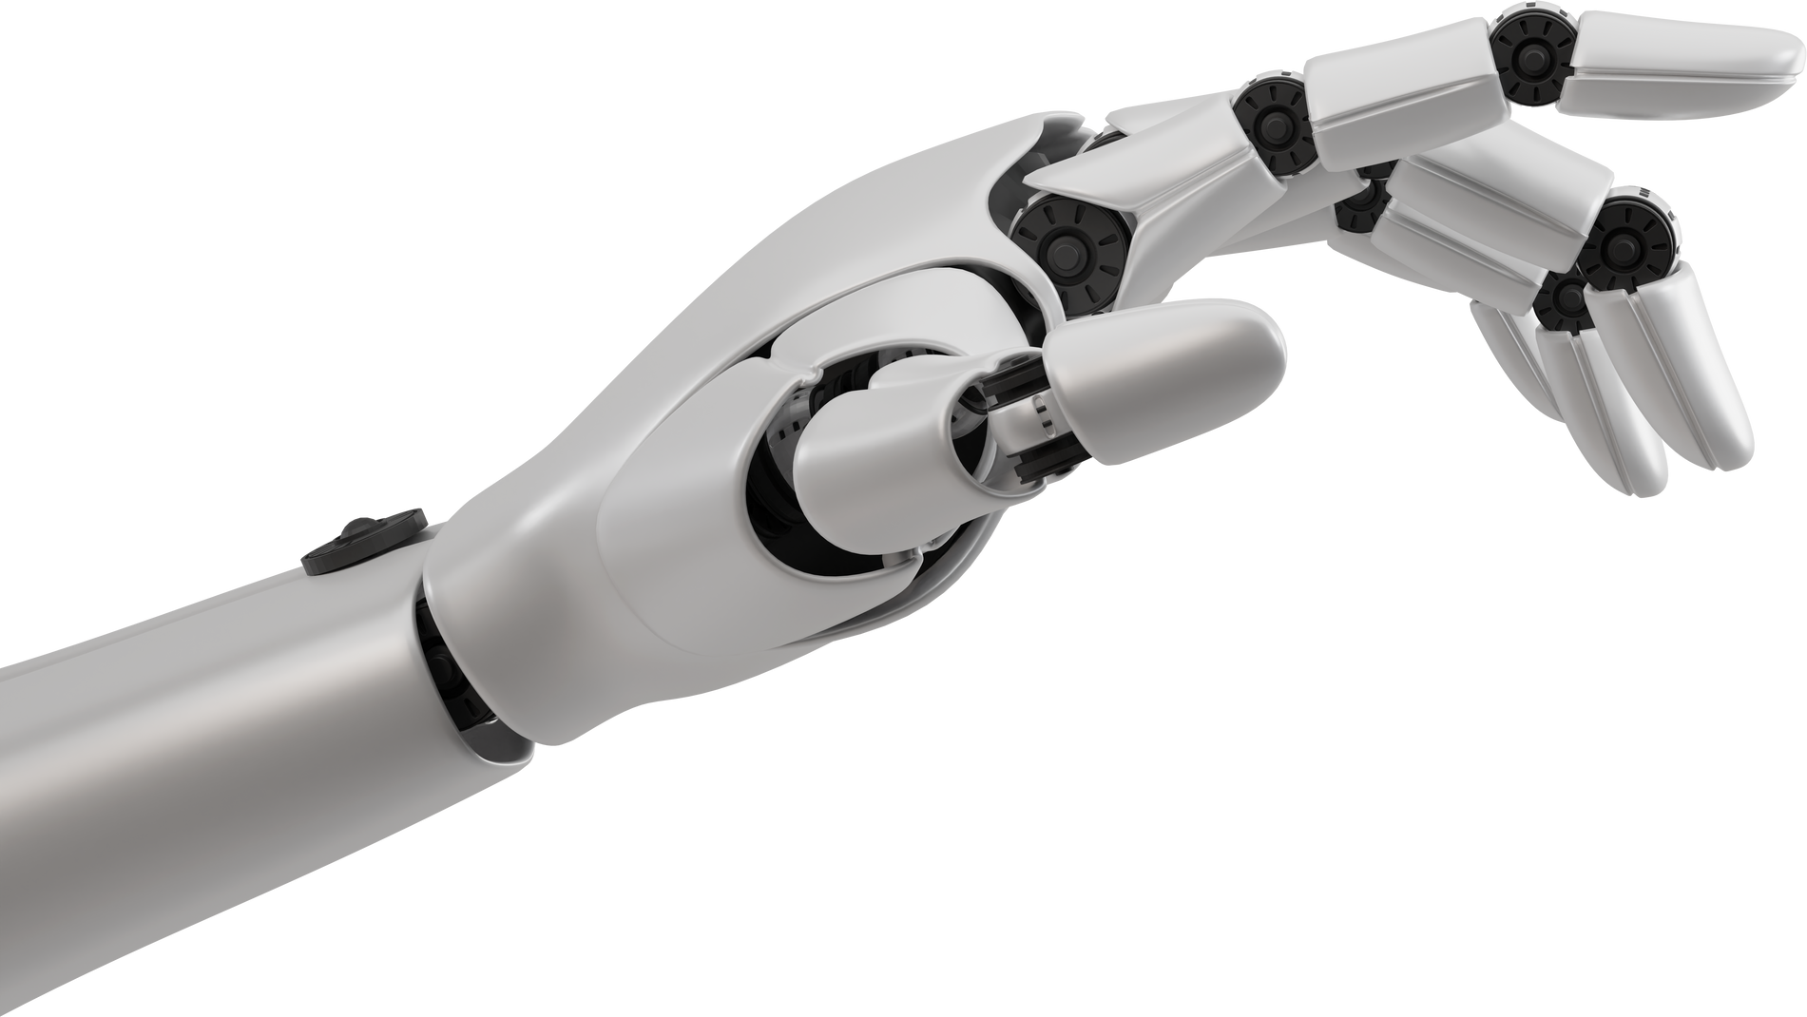
UNIQUE IDEA BRIEF (SOLUTION)
Leveraging Intel Edge Developer Cloud for compatibility and performance.
Utilizing Intel OpenVINO for model optimization.
Focus on CPU-based inference and fine-tuning to avoid the need for expensive GPUs.
Focus on converting models to FP16, INT8, and INT4 formats for improved performance.

Slide 4

FEATURES OFFERED
Performance Enhancement:
FP16, INT8, and INT4 optimizations for faster and more efficient execution.
Resource Efficiency:
CPU optimization reducing reliance on GPUs
Cost-Effectiveness:
Utilization of existing Intel CPU resources, broad deployment options.
Efficient inference using neural-chat-7b-v3-1 model.
Fine-tuning capabilities with Meta-LLama-2-7b-hf model.
Model optimization using FP16, INT8, and INT4 formats for better performance.

Slide 5

PROCESS FLOW
Environment Setup:
Intel Edge Developer Cloud platform
Python 3.10 (OpenVINO Notebooks 2024.1.0)
Model Selection and Configuration:
Inference Model: neural-chat-7b-v3-1
Fine-Tuning Model: Meta-LLama-2-7b-hf
Optimization:
FP16, INT8, and INT4 conversions
Inference and Fine-Tuning Processes:
Tokenization, training setup, model export, and benchmarking

Slide 6
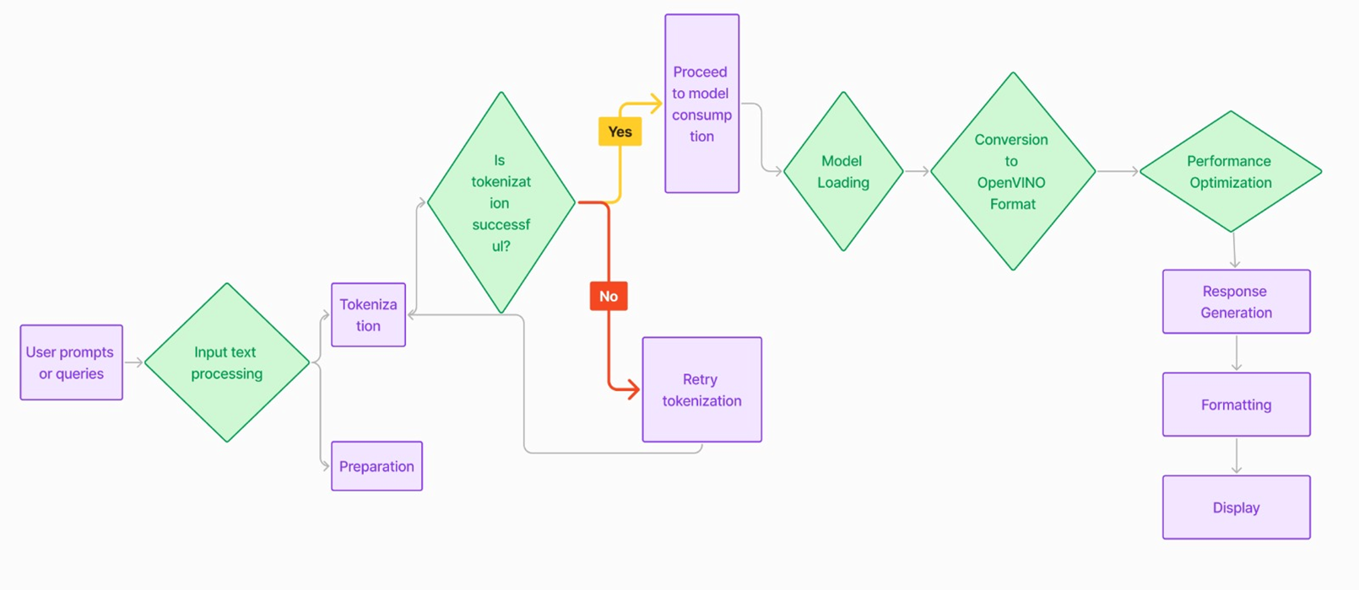
ARCHITECTURE
figure 1: Inference Process
fig

Slide 7
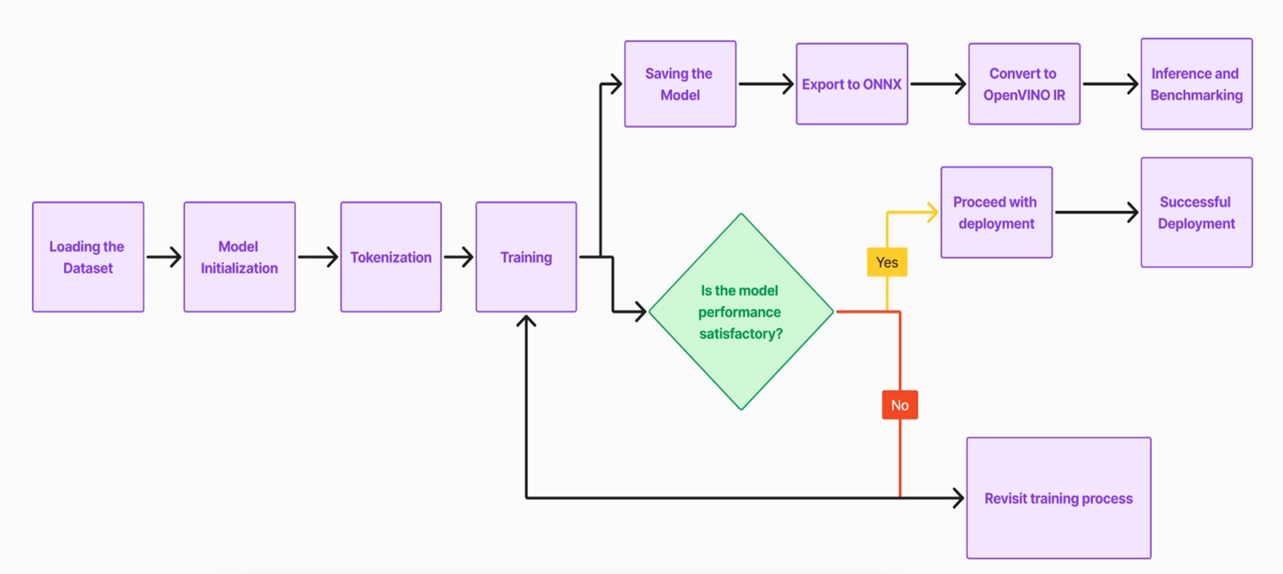
ARCHITECTURE
Figure 2: Fine-TuningProcess

Slide 8

TECH STACK USED:
Platform:
Intel Edge Developer Cloud
Kernel:
Python 3.10 (OpenVINO Notebooks 2024.1.0)
CPU:
Intel(R) Xeon(R) Gold 5218R CPU @ 2.10GHz
Libraries and Tools:
OpenVINO
Hugging Face transformers library
torch.onnx.export

Slide 9

Models:
Inference Model: neural-chat-7b-v3-1
Fine-Tuning Model: Meta-LLama-2-7b-hf
Dataset:
Wikitext-2-raw-v1
Transformers Library :
(AutoTokenizer, OVModelForCausalLM)
Hugging Face Trainer API
ONNX (Model Export)
PyTorch (Model Training)

Slide 10
TEAM MEMBERS AND CONTRIBUTION:
Farhan Khan:
He set up the fine-tuning environment using Intel OpenVINO and fine-tuned the Meta-LLama-2-7B-HF model for specific tasks.
He evaluated the performance of the fine-tuned model and documented the entire fine-tuning process and results
Sowmya:
She set up the environment on Intel Developer Cloud Edge and implemented LLM inference using the Neural-Chat-7B-v3-1 model.
She tested and validated the model’s performance on CPU and successfully demonstrated inference with test data.

Slide 11


CONCLUSION:
Significant improvements in inference performance and efficiency using OpenVINO.
Viable solution for deploying AI models on existing hardware infrastructure.
Future work includes further optimizations, real-world application integration, and comprehensive benchmarking
Successful implementation of GenAI models on Intel laptops using openvino.

Slide 12

FUTURE DIRECTIONS:
Explore additional OpenVINO optimizations.
Integrate optimized models into real-world applications.
Conduct comparative studies for performance evaluation.
Integrate models into real-world applications

Slide 13

VIDEO DEMO LINK
Click Here!!

